Slide 1
Guide for images annotation
By Zhang Chenkai
zhang1354558057@gmail.com

Slide 2
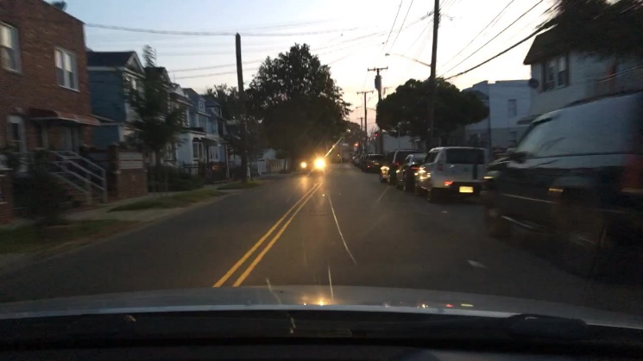
Real driving images
For every image, four kinds of driving action label are needed:
1. Can speed up 2. Can go left 3. Can go right 4. Must slow down
The default current state of the vehicle is moving forward with a constant speed.
Based on this default state and the road information, we decide three actions are available or not.
Important point:
We only drive on the road, no need consider the parking lot, garage, etc.
Consider which action is appropriate as moving forward.
For example,
1. Can speed up : True
2. Can steer left : False (Solid line in the left side)
3. Can steer right : False (Car in the right side)
4. Must slow down: False

Slide 3
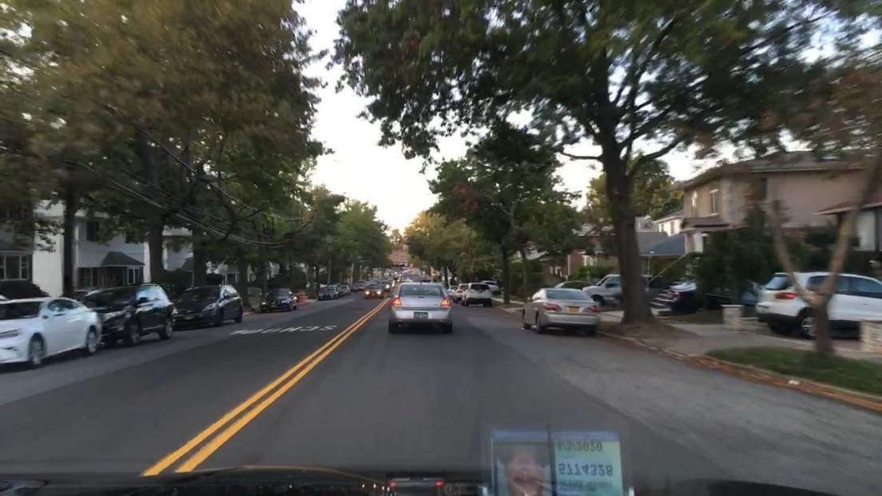

Can speed up
More than safe distance
Ego
The distance between the front car and ourselves are long enough, so we can speed up without causing accidents.
Can Speed up : True

Slide 4
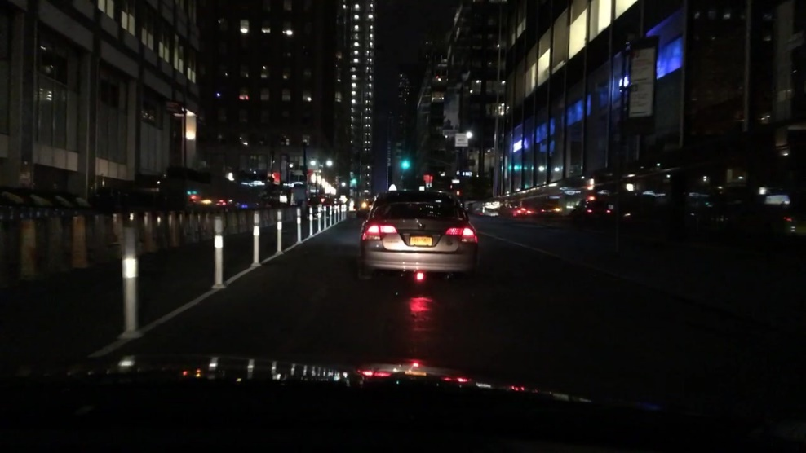
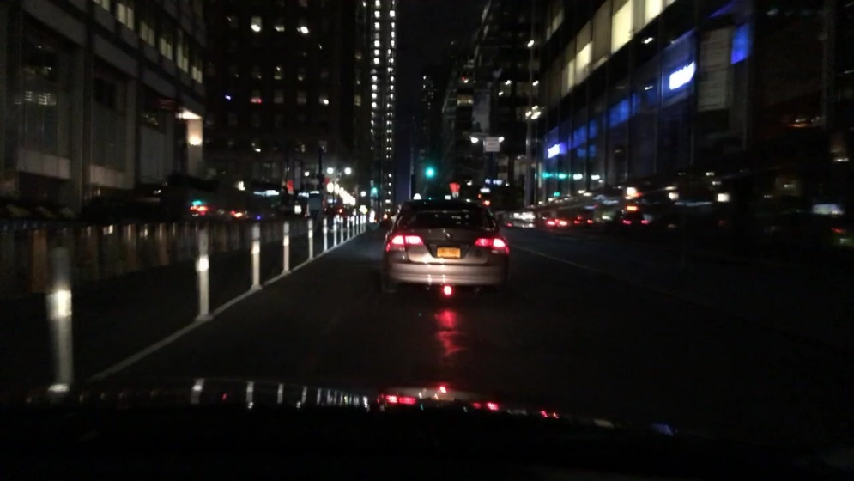
Can speed up
The distance between the front car and ourselves are not long enough, so we can’t speed it up without causing accidents.
But we can also keep this distance, we don’t have to slow down.
Equal to safe distance
Can speed up： False
Must slow down: False
Ego

Slide 5
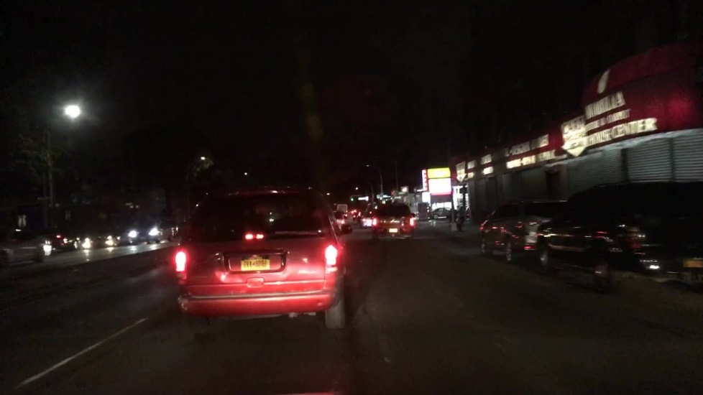
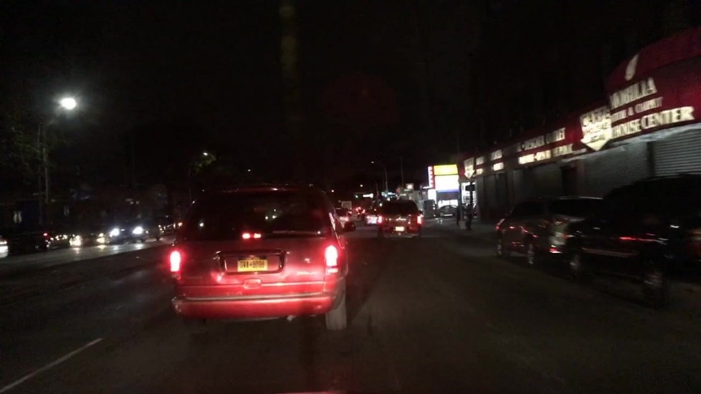
Can speed up
The distance between the front car and ourselves are not long enough, so we can’t speed it up without causing accidents.
We cannot keep this speed either, we have to slow down because the forward car are getting closer.
Less than safe distance
Can speed up： False
Must slow down: True
Ego

Slide 6





Can steer left
Steer Left
Ego
Ego
Can steer left:
1.Left lane change
2.Turn left
3. U turn
…
Ego
Ego
Ego

Slide 7
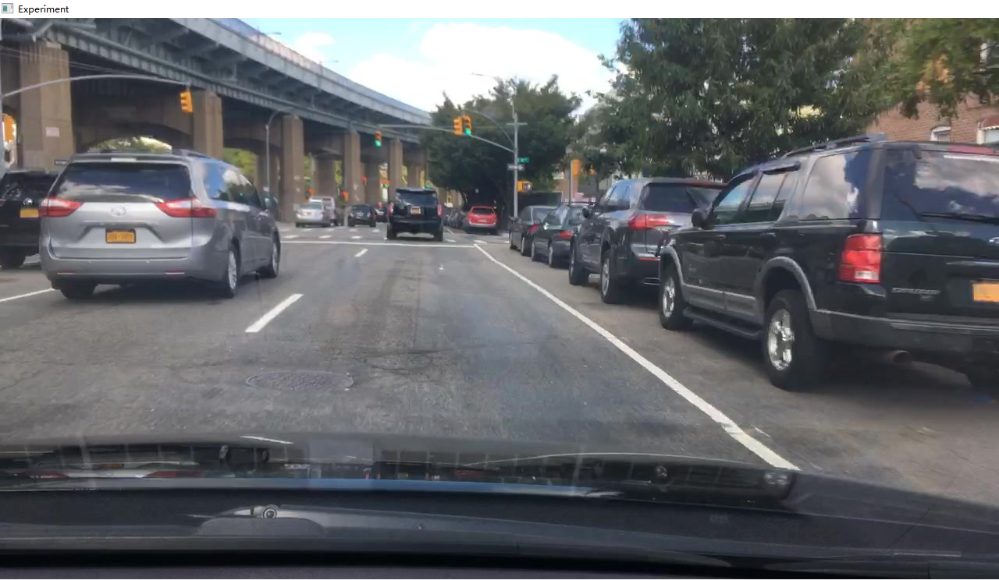
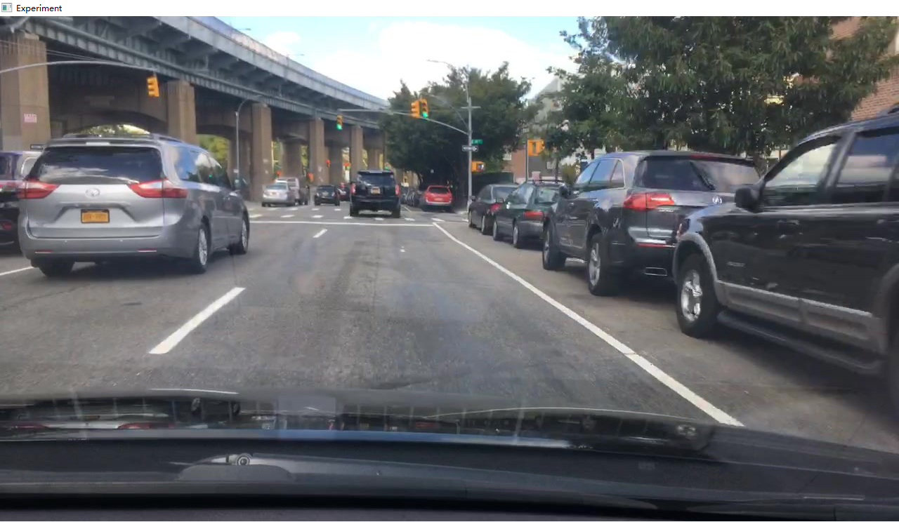
Can steer left
Can steer left : False
Time step 1
Time step 2
Turn left :
We will occupy the space in front of the left.
The problem is, by how much? -> Based on current speed.
i.e. More speed, more space

Slide 8
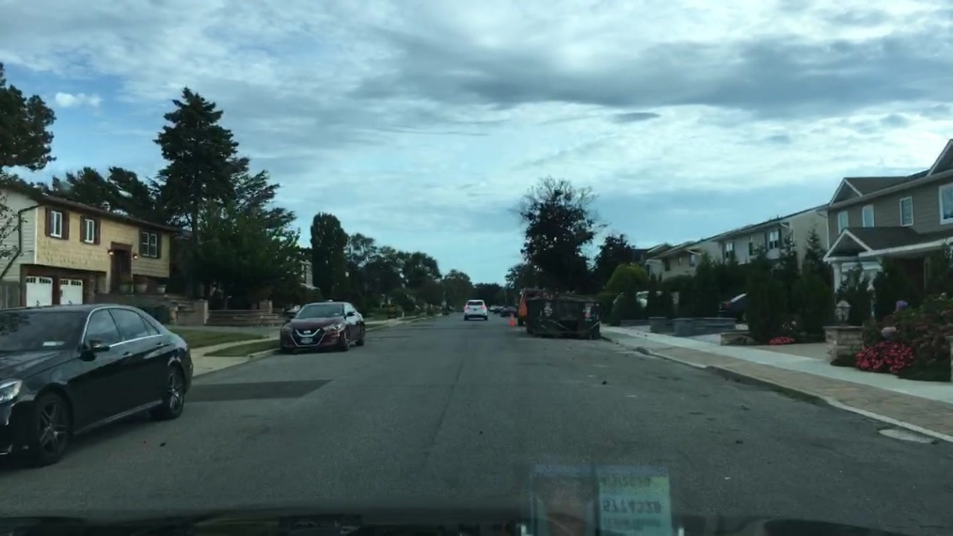
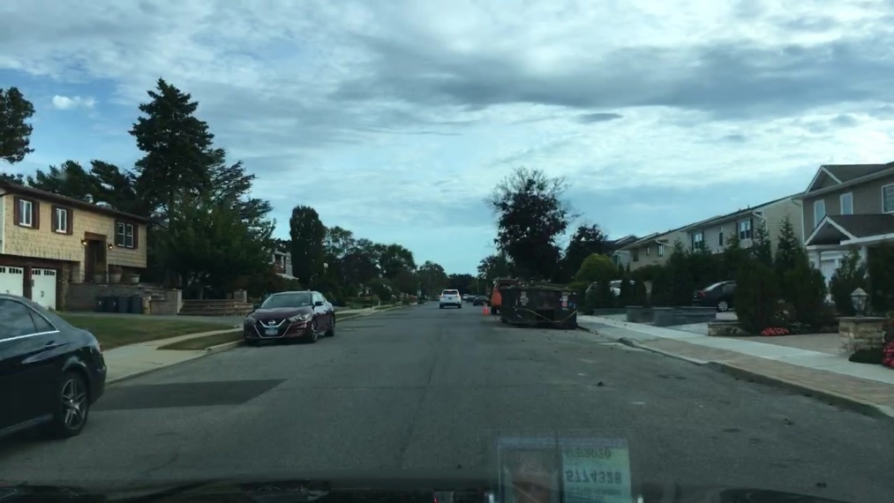
Can steer left
Time step 1
Time step 2
There are vehicles on the right side and will affect our “Turn left” option.
Can steer left : False
Ego

Slide 9
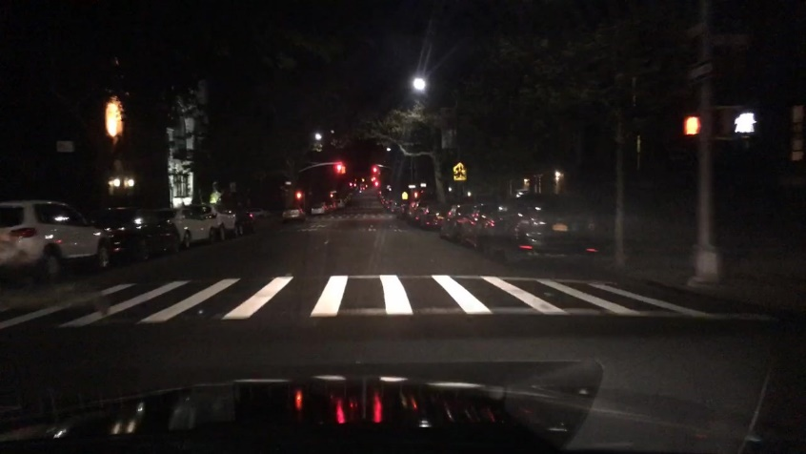
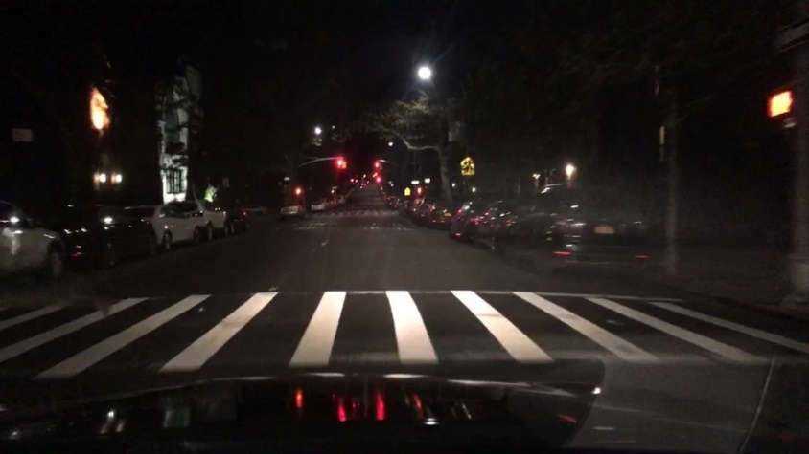
Can steer left (Can steer right)
Time step 1
Time step 2
There are vehicles on the right side and the left side in the front, however the vehicles on the right side are closer to us which will affect our “steer right” option.
Can steer left : True
Can steer right : False
Ego

Slide 10
Steer left
Original state (Moving forward)
Moving forward + steer left action
More speed, more space
Occupy space
Based on speed
Constant
Ego
Ego
Ego
No matter it is a lane change or a left turn, we must first occupy the space on the left side, so “steer right” can represent either a lane change or a left turn.

Slide 11

Simulation : Make predictions based on limited information
Gray areas are considered to be nothing.
There is a car in front of us, so the “Forward” action is unavailable
1. Can speed up : False
2. Can steer left : True
3. Can steer right : True
4. Must slow down: False

Slide 12
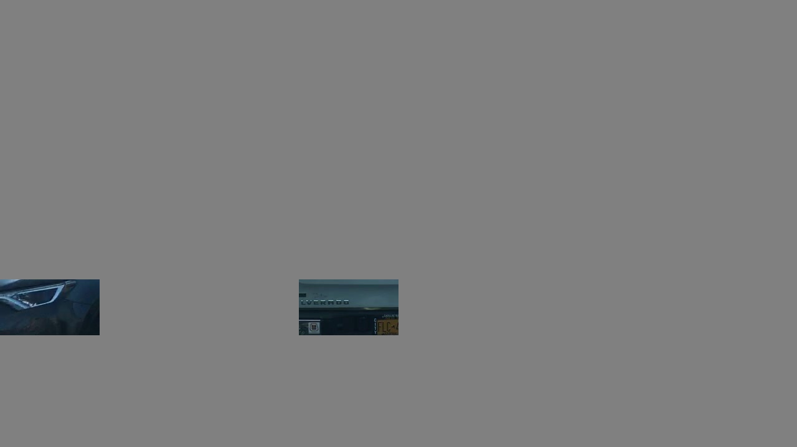
Simulation : Make predictions based on limited information
There is a car on the left, so the “Turn left” action is unavailable
1. Can speed up : False
2. Can steer left : False
3. Can steer right : True
4. Must slow down: False

Slide 13
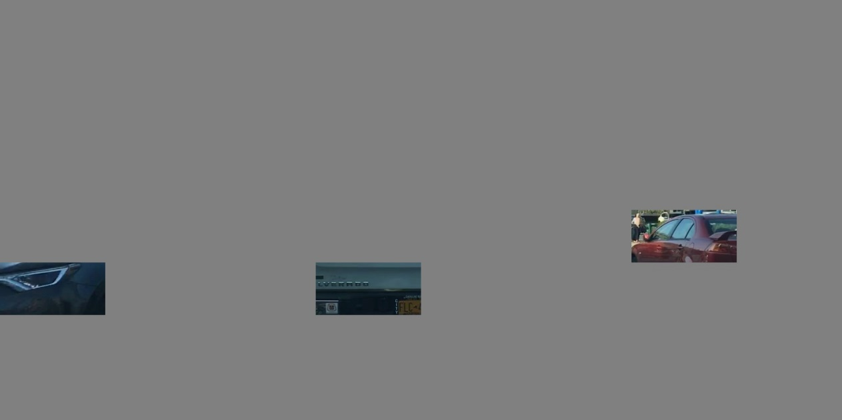
Simulation : Make predictions based on limited information
This situation is ambiguous but I made a judgment call, I think this car is close to us so the “turn right” action is unavailable. There is a car on the right, so the “Turn right” action is unavailable.
1. Can speed up : False
2. Can steer left : False
3. Can steer right : False
4. Must slow down: False

Slide 14
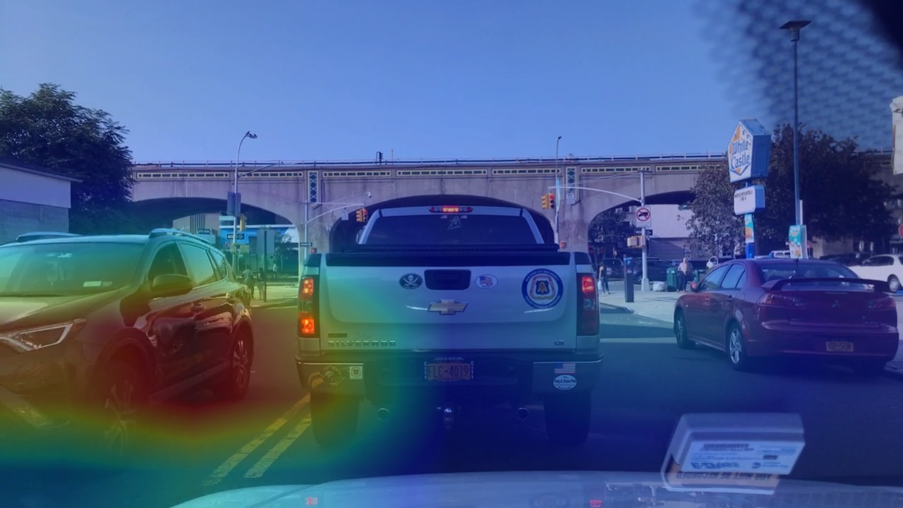
Subject evaluation
Heatmap trustiness evaluation:
1：Excellent
2：Good
3：Fair
4：Poor
5：Bad
1.The car on the left, 2.the car in front of us 3.and the solid line on the left are used by the model, so I think the heat map trustiness this is pretty high.

Slide 15
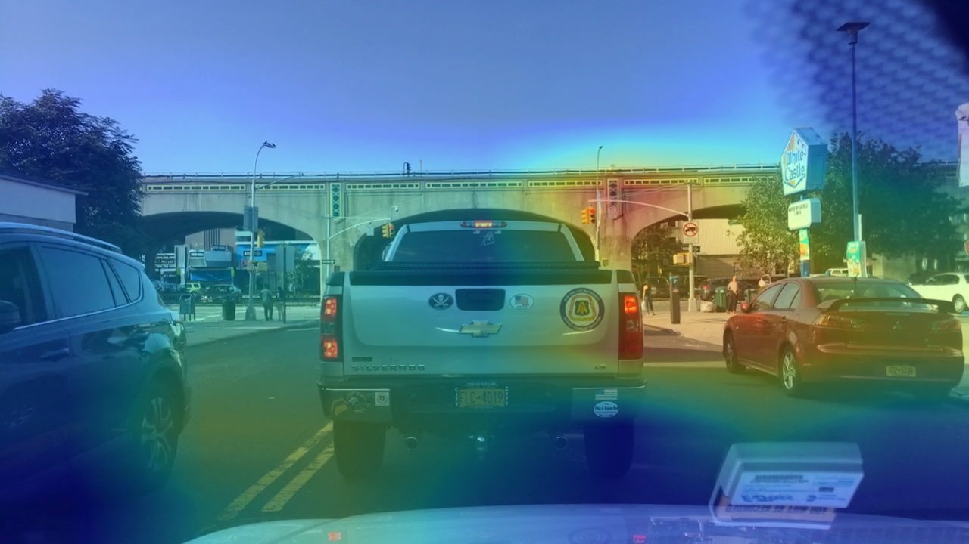
Subject evaluation
Heatmap trustiness evaluation:
1：Excellent
2：Good
3：Fair
4：Poor
5：Bad
The driving model doesn't pay attention on the vehicles, so I don’t think the driving method is good.

